Slide 1
Minimum Local Disk Cover Sets for Broadcasting in Heterogeneous Wireless Ad Hoc Networks
2007 International Conference on Parallel Processing Workshops (ICPPW 2007) Chih-Wei Yi, Fang-Chun Liu, Min-Te Sun
報告人 楊翔雲、李政遠

Slide 2
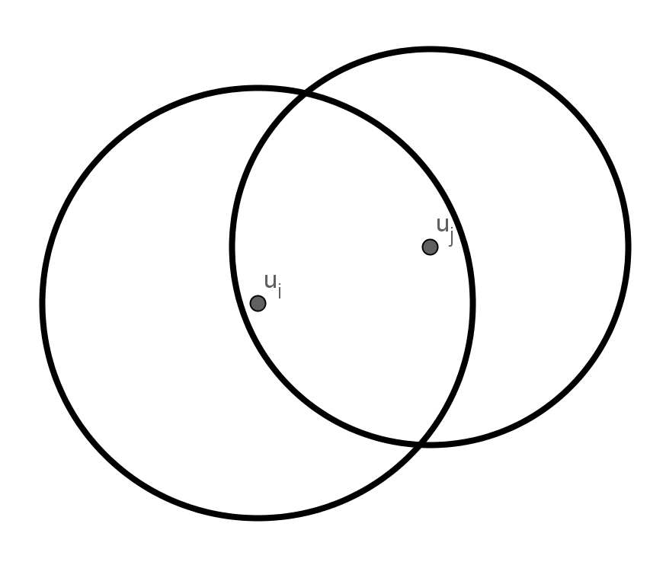
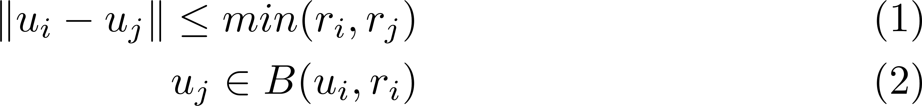
Definition

Slide 3
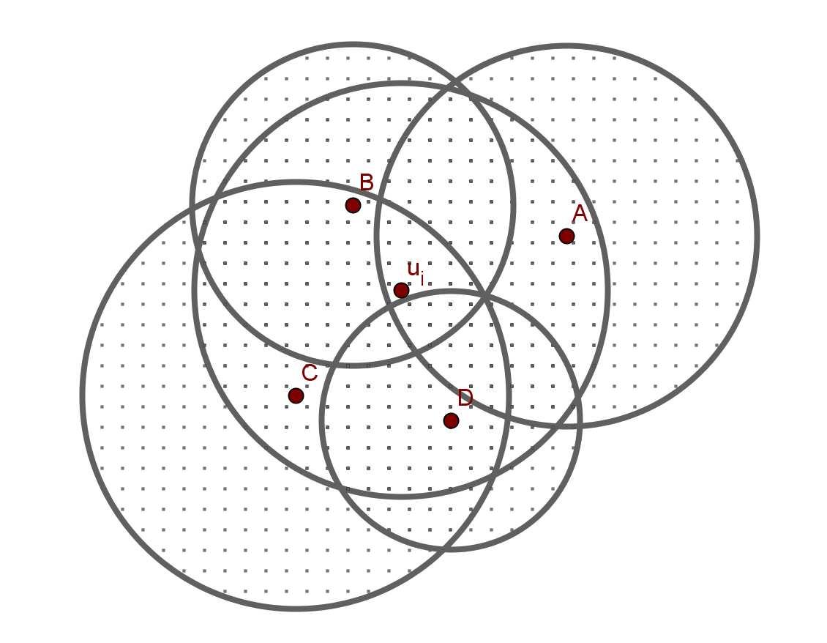
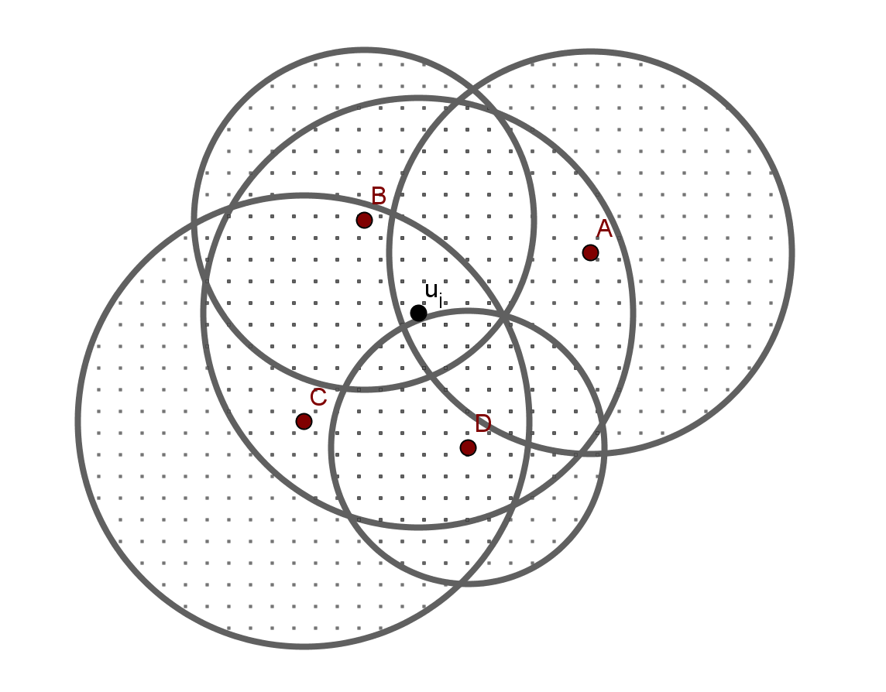
Definition

Slide 4
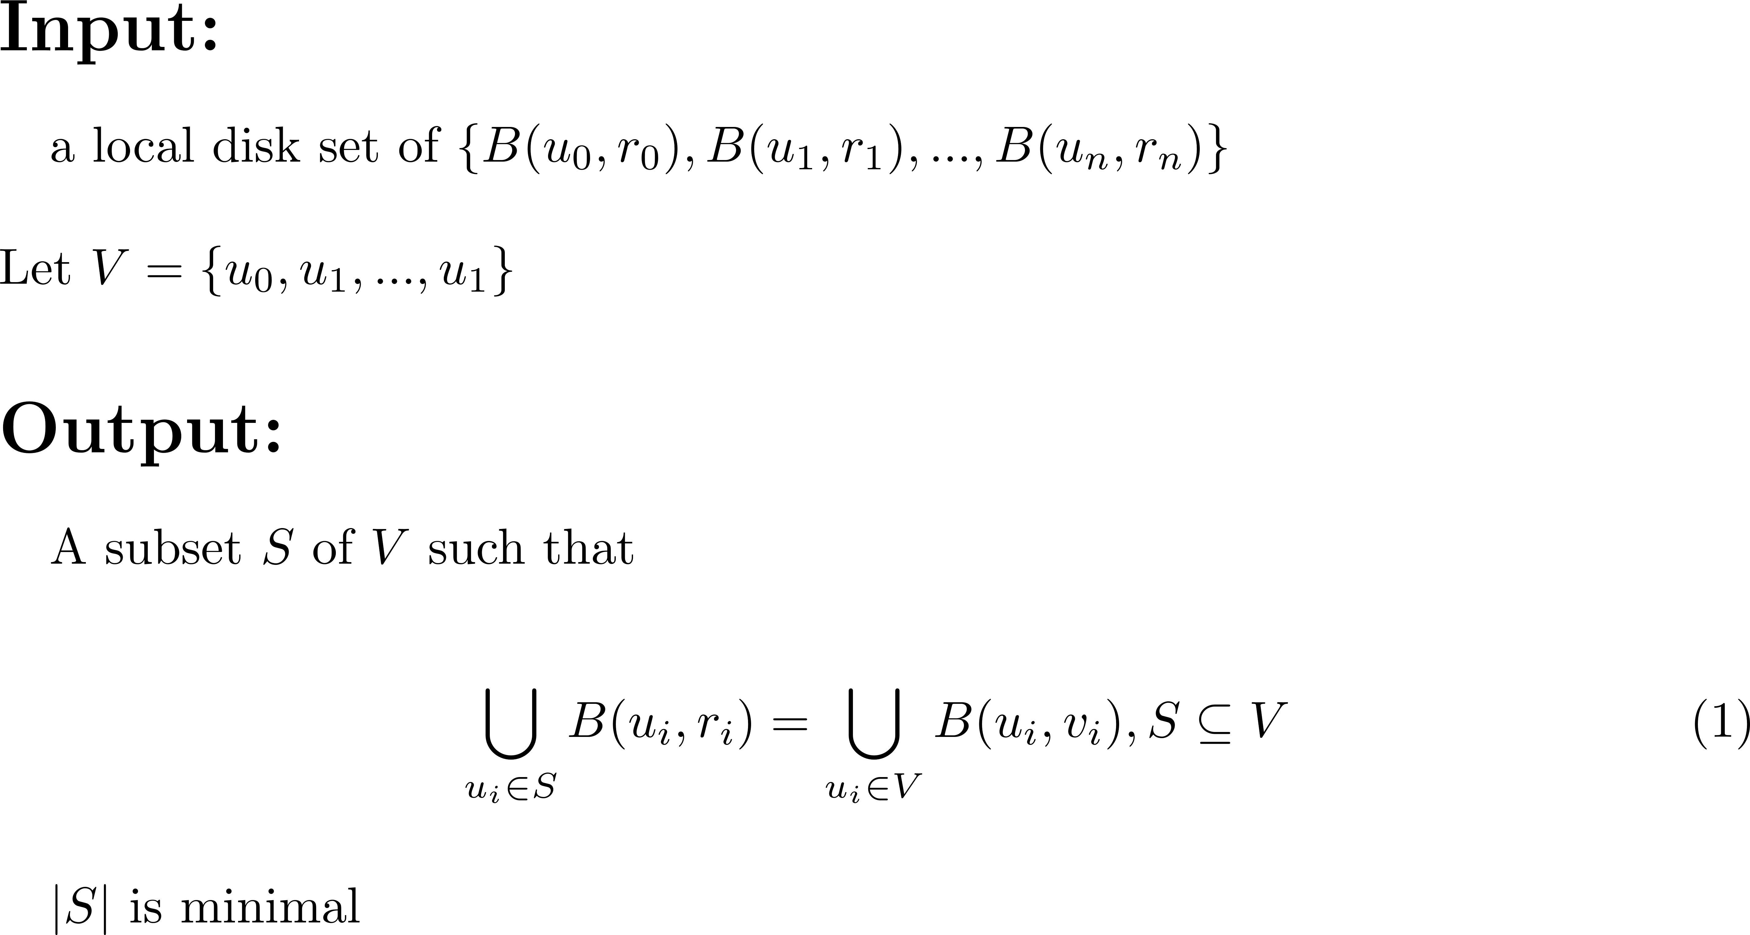
Problem
一堆小圓，找最少個數的小圓并 = 整體圓并

Slide 5
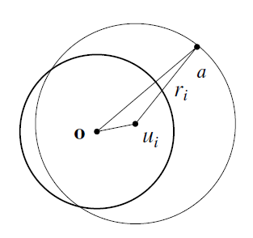
Skyline Set – for MLDC
Skyline is composed of arcs of disks.
Lemma 1: For any point a ∈ ∂B (u_{i}, r_{i}), the line segment oa ⊂ B (u_{i}, r_{i}). Proof. o ∈ B (u_{i}, r_{i}) and ||o − u_{i}|| ≤ r_{i} B (u_{i}, r_{i}) is concave and o, a ∈ B (u_{i}, r_{i}), the line segment oa ⊂ B (u_{i}, r_{i}).

Slide 6
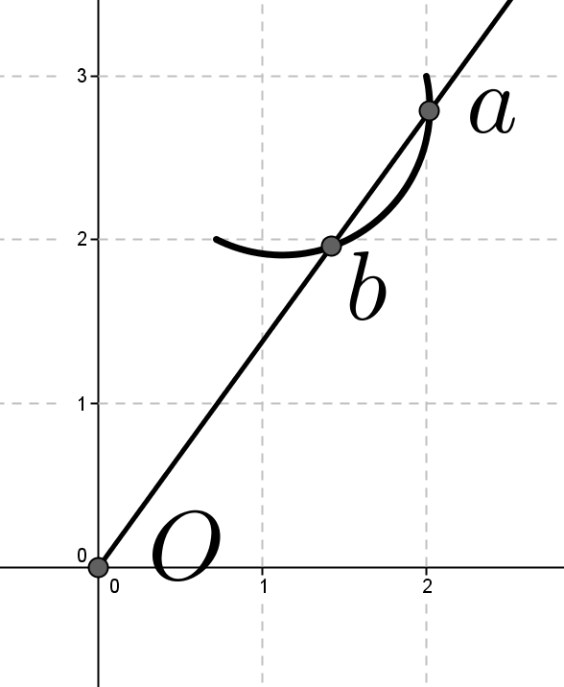
Skyline Set – for MLDC
Corollary 2 A ray from o intersects the skyline at exactly one point
Proof. by contradiction. Assume a is farther from o than b. Since a is in the skyline, a is in ∂B (u_{i}, r_{i}) for some i. According to Lemma 1, we have oa ⊂ B (u_{i}, r_{i}). This implies b is inside of B (u_{i}, r_{i}), and b cannot be in the skyline.

Slide 7
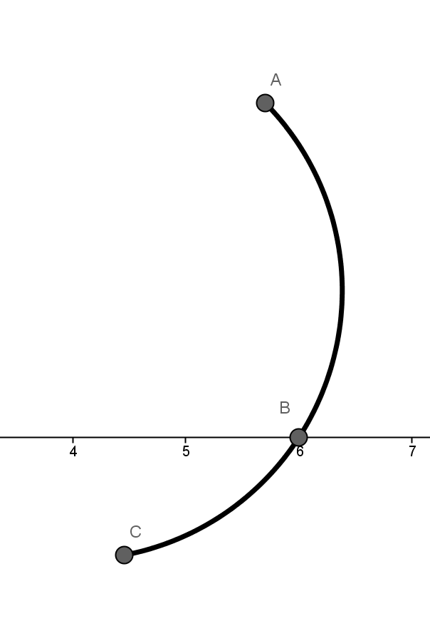
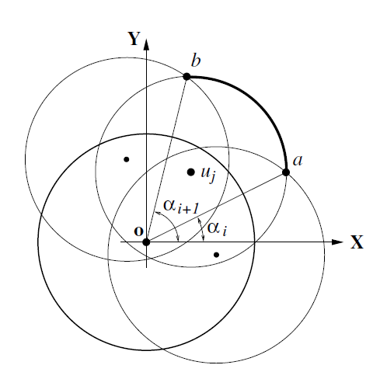
Skyline Set – expr for MLDC
Define arc = (α_{i}, u_{j}, r_{j}, α_{i+1}), 0 < α_{i} < 2π
Define skyline = (α₀, u_{s0}, r_{s0}, α₁, u_{s1}, r_{s1}, α₂, ..., α_{n})
AC divide to AB and BC

Slide 8
Skyline Set – expr for MLDC
Theorem 3 For a given local set V = {u₀, u₁, . . . , u_{n}}, its minimum local disk cover set is the skyline set for the corresponding local disk set {B(u₀, r₀), B(u₁, r₁), . . . , B(u_{n}, r_{n})}.
First, prove skyline set is a local disk cover set. 聯集結果相同。
Second, prove if B (u_{i}, r_{i}) is in the skyline set, B (u_{i}, r_{i}) must be in any disk cover set. 任何在 skyline set 的 u_{i} 會在任何解集合中(包括最佳解)，意即 B (u_{i}, r_{i}) 存在自己的特別區域。

Slide 9
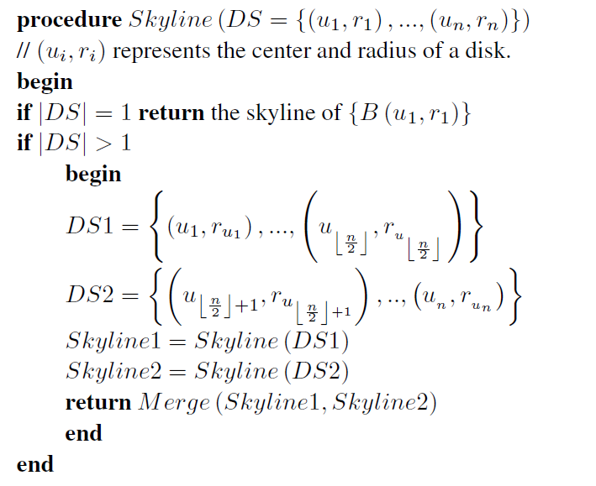
D&C algorithm – Skyline

Slide 10
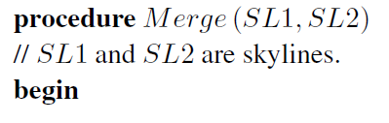
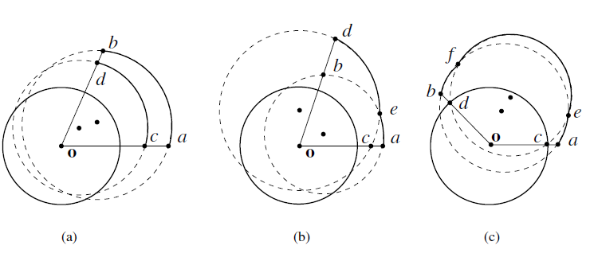
D&C algorithm – Merge
對齊一開始合併的角度，先根據 SL1 合併，之後在合併 SL2，分別殘存的 arc list 再進行 merge

Slide 11
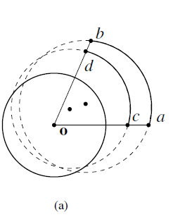
D&C algorithm – Merge-Case1
Arcs (α, u, r_{u}, β) and (α, v, r_{v}, β) have no intersection. One arc is closer to o than the other, and the arc closer to o can not be in the new skyline. For instance.

Slide 12
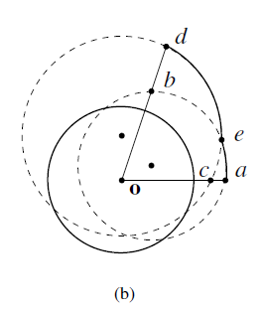
D&C algorithm – Merge-Case2
Arcs (α, u, r_{u}, β) and (α, v, r_{v}, β) intersect at one point e. Let γ be the angle corresponding to the intersection point. Applying the principle used in Case 1, new skyline arcs can be decided from arcs (α, u, r_{u}, γ) and (α, v, r_{v}, γ), and arcs (γ, u, r_{u}, β) and (γ, v, r_{v}, β).

Slide 13
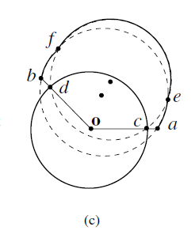
D&C algorithm – Merge-Case3
Arcs (α, u, r_{u}, β) and (α, v, r_{v}, β) intersect at two points e, f. Let γ₁ and γ₂ with γ₁ < γ₂ be angles corresponding to intersection points. Applying the principle used in Case 1, new skyline arcs can be decided from arcs (α, u, r_{u}, γ₁) and (α, v, r_{v}, γ₁); arcs (γ₁, u, r_{u}, γ₂) and (γ₁, v, r_{v}, γ₂); and arcs (γ₂, u, r_{u}, β) and (γ₂, v, r_{v}, β).

Slide 14
D&C algorithm – Analysis
Merge() time complexity: f(n)
f(n) is linear with respect to #arcs. According to the master theorem T(n) = O(n log n)
homogeneous networks < heterogeneous networks
homogeneous networks is at least O(n ln n), O(n log n) algorithm is optimal time complexity for MLDS.

Slide 15
Geometry of Disks – in general
#arcs in a skyline can not be more than 2n
In fact, a disk may increase arcs more than two arcs.
之前是依靠每一次加入的圓，最多貢獻 2 arcs。來確保整體不超過 2n arcs。f (n) = O(n)
如果從半徑由大到小依序 Merge()，則 Merge 過程中整體的 arcs 不超過 2n 個。即使有一個圓貢獻大於 2 個 arcs。

Slide 16
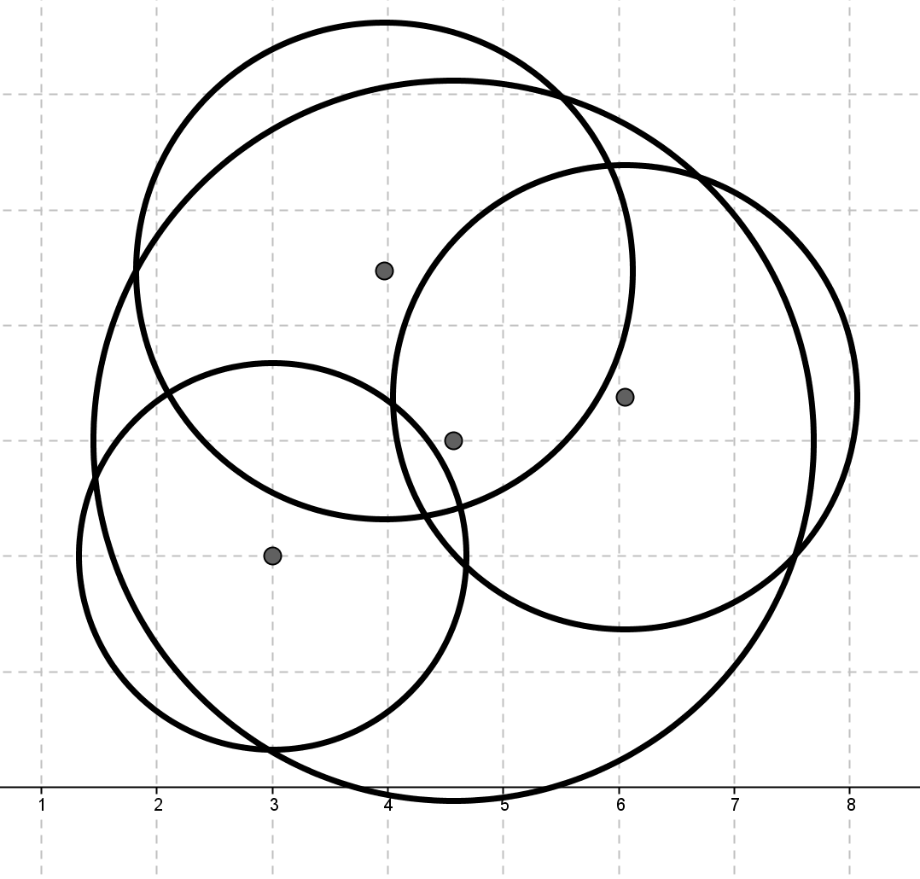
Geometry of Disks – in general
Lemma 5 In the skyline of {B₁,B₂, . . . , B_{n}}, if B_{n} contributes at least three arcs, then we can pick B_{i}, B_{j}, B_{k} from B₁, B₂, . . . , B_{n−1} such that B_{n} contributes three arcs in the skyline of B_{i}, B_{j}, B_{k}, B_{n}
等下用來證明的 Case 狀況

Slide 17
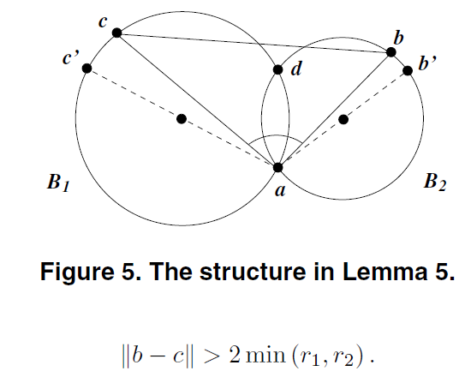
Geometry of Disks – in general
Lemma 6 Assume two circle ∂B1 and ∂B2 have two intersection points a and d. Let ac (and ab, respectively) be a diameters of B1 (and B2, respectively), and c (and b, respectively) is a point in arc cd (bd respectively). See Fig. If the angle ∠cab is obtuse, we have
包含兩點 bc 的圓半徑 必然大於 min(r₁, r₂)

Slide 18
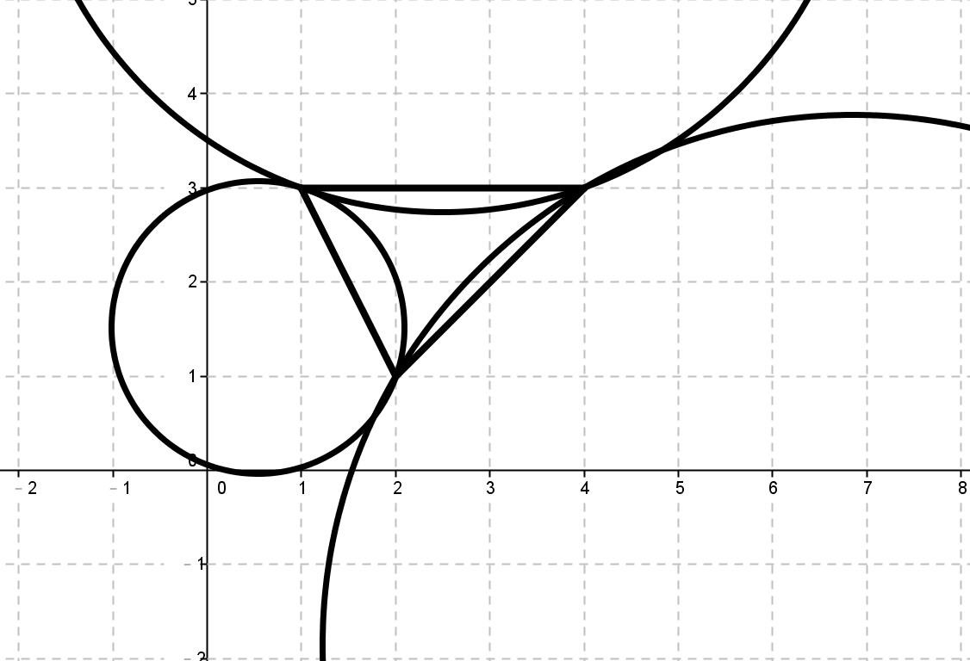
Geometry of Disks – in general
Lemma 7 Given an acute or right triangle, for each edge of the triangle, draw a circle with the edge as a chord whose center is outside the triangle and radius is larger than the circumradius. Then, three circles have no intersection.
用來證明包含三頂點的 圓半徑小於三個邊外圓半徑， 會造成三個外圓沒有相交。

Slide 19
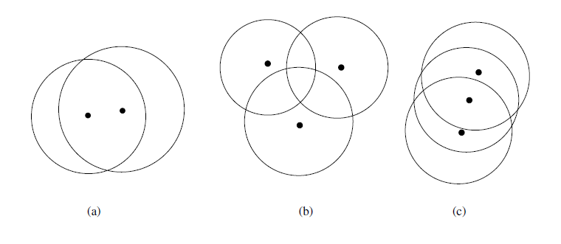
Geometry of Disks – in general
Lemma 8 The number of arcs in a skyline of n disks is at most 2n.
prove by mathematical induction Basis

Slide 20
Geometry of Disks – in general
Prove Lemma 8 cont.
Assume that as n = k, the skyline contains at most 2k arcs. If we can show that after a disk B_{k+1} is added into the set, the number of arcs in the skyline increases at most by two, then the new skyline contains no more than 2 (k + 1) arcs prove by mathematical induction.
Assume B_{k+1} can contribute at least 3 arcs. According to Lemma 5, without loss of generality, we may assume that B_{k+1} contributes 3 arcs in the skyline of B₁, B₂, B₃, B_{k+1}.

Slide 21
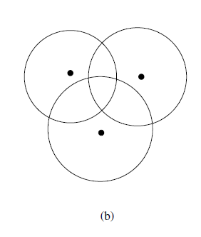
Geometry of Disks – Lemma 8
Prove Lemma 8 cont.
Figure (b) one of intersections with B₁, B₂, B₃ (1) Δabc is an acute or right triangle (2) Δabc is an obtuse triangle

Slide 22
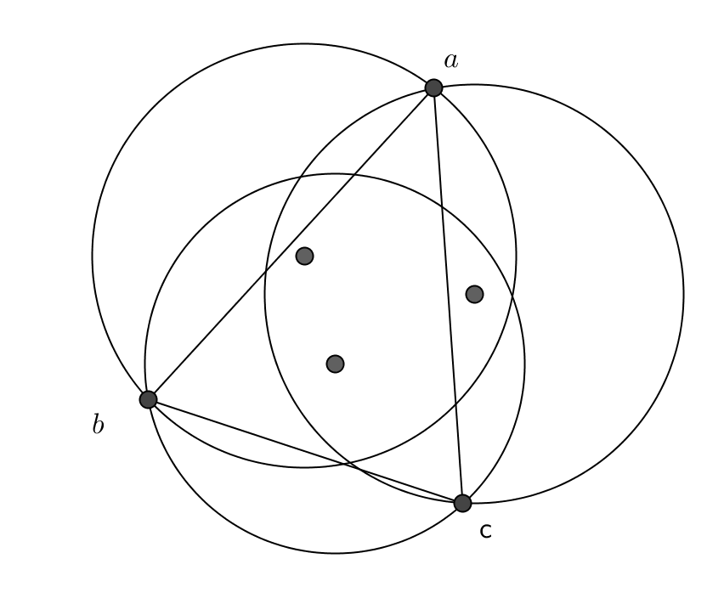
Geometry of Disks – Lemma 8
Case 1: Δabc is an acute or right triangle. Let r_{c} be the circumradius of Δabc. B_{k+1} contains a, b, c, we have r_{k+1} > r_{c}. B_{k+1} is the smallest among B₀, B₁, B₂, . . .,B_{k+1} r_{c} < r_{k+1} ≤ r₁, r₂, r₃ By Lemma 7, if r₁, r₂, r₃ are larger than r_{c}, then B₁, B₂, B₃ have no intersection.
Impossible Case.

Slide 23
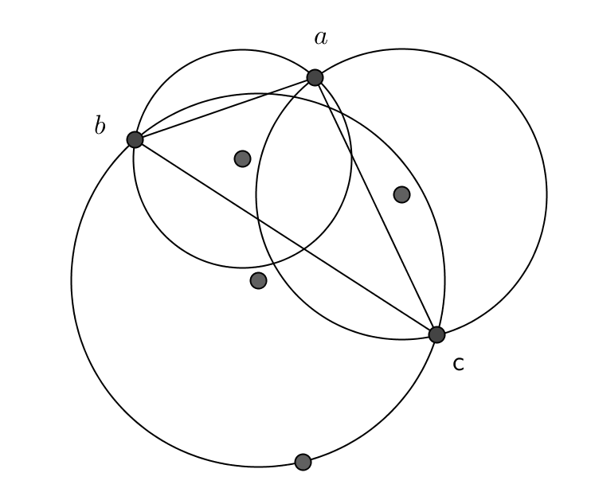
Geometry of Disks – Lemma 8
Case 2: Δabc is an obtuse triangle
Let r_{c} be the circumradius of Δabc. B_{k+1} is the smallest among B₀, B₁, B₂, . . .,B_{k+1} r_{k+1} ≤ r₁, r₂, r₃ By Lemma 6, ∠cab is obtuse, we have ||b − c|| > 2 min(r₁, r₂). B_{k+1} contains Δabc, we have r_{k+1} ≥ ½|| b − c ||.
Impossible Case.

Slide 24
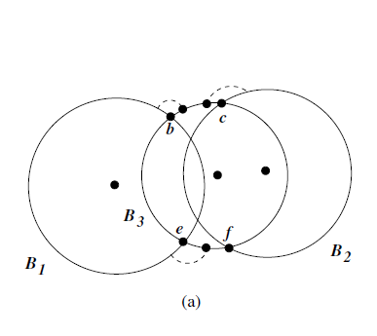
Geometry of Disks – Lemma 8
Figure (c) one of intersections with B₁, B₂, B₃
Case 3. B_{k+1} cover exactly 3 intersection points.
B_{k+1} must have 3 intersection points with B₃. This is impossible to happen.
兩圓最多交兩點！

Slide 25
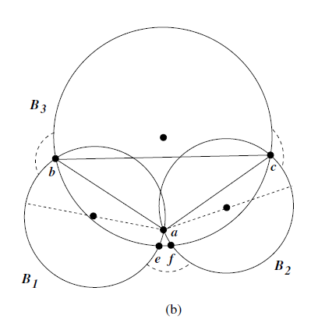
Geometry of Disks – Lemma 8
Case 4. If B_{k+1} cover exactly 4 intersection points.
Since B_{k+1} is smaller than B₁, B₂, B₃, arcs bc of B₃ outside B₁, B₂, arc be of B₁ outside B₃, and arc ef of B₂ outside B₃ are larger than π. ∠ bac > π/2 By Lemma 6, B_{k+1} contains Δabc, we have r_{k+1} ≥ ½|| b − c ||.
r_{k+1} > min(r₁, r₂) ⇒ Impossible Case.

Slide 26
Geometry of Disks – Lemma 8
Assume B_{k+1} can contribute at least 3 arcs. According to Lemma 5, without loss of generality, we may assume that B_{k+1} contributes 3 arcs in the skyline of B₁, B₂, B₃, B_{k+1}.
Case 1 ~ 4 are impossible.
The number of arcs in the skyline B₁,B₂, · · · ,B_{k+1} is at most 2(k + 1). By mathematical induction, we conclude that the number of arcs in the skyline of n disks is upper bounded by 2n.

Slide 27
Conclusions
Merge() time complexity: f(n)
f(n) is linear with respect to #arcs.
According to the master theorem T(n) = O(n log n)
If the disks are added into the disk set follows the descending order of radius, #arcs = O(2n) and f(n) = O(n) which proved in Lemma 8.

